Slide 1
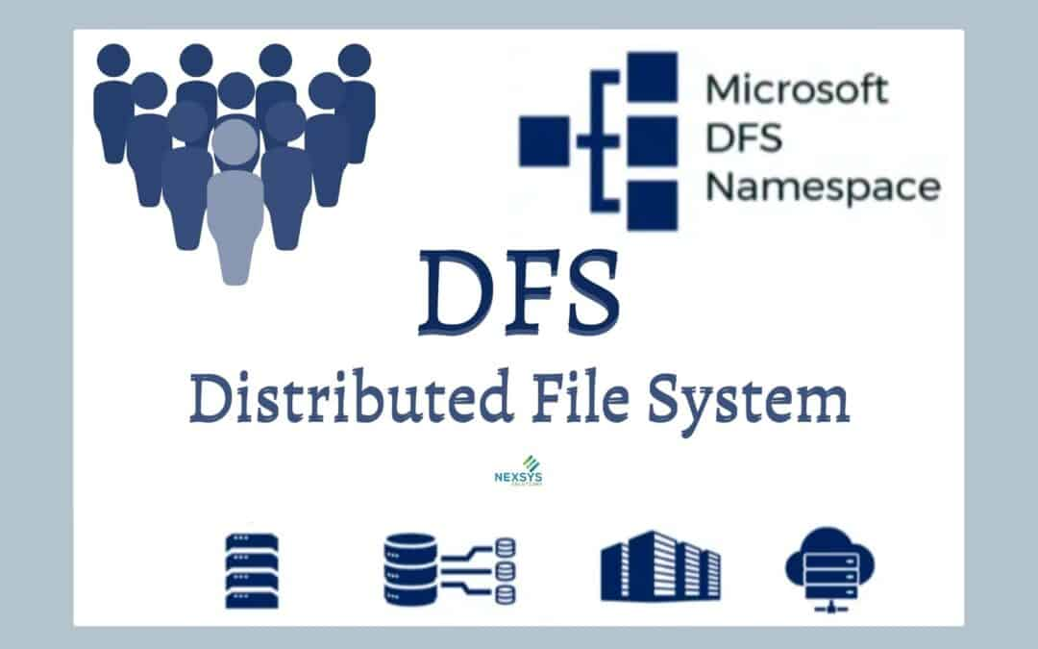
Agenda
Introduction to Distributed File Systems: Understand why they are important in today's computing landscape
Individual File System Overviews: Brief introductions to PVFS2, LustreFS, BeeGFS, GlusterFS, and Ceph, including their histories, pros/cons, use cases, and unique features
Comparative Analysis: Dive into a sidebyside comparison of the five file systems, focusing on key characteristics such as performance, scalability, reliability, and manageability
This Photo by Unknown author is licensed under CC BY-ND.

Slide 2
Introduction
The Need for Distributed File Systems: As we generate more data than ever before, there's a growing need for distributed file systems that can handle massive data volumes, maintain high performance, and ensure data availability
PVFS2: An opensource parallel file system designed for high performance computing on largescale scientific simulations
LustreFS: A robust parallel distributed file system widely used for largescale cluster computing
BeeGFS: This high performing file system is known for its flexibility and ease of use in high performance computing environments
GlusterFS: A scalable network file system suitable for data intensive tasks over a large number of servers
Ceph: A unified, distributed storage system that emphasizes performance, reliability, and scalability, offering object, block, and file storage in one platform

Slide 3
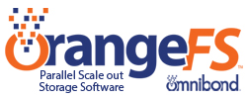
PVFS2
Introduction: PVFS2, designed for highperformance computing, is an opensource, parallel file system that uses commodity hardware
Pros: High scalability, excellent for large sequential read/write workloads
Cons: Not fully POSIX compliant, lacks data redundancy features, and less robust against hardware failures
Use cases: Often used in largescale scientific simulations and data intensive environments
Unique Features: Optimized for parallel access of large datasets, scalable I/O bandwidth

Slide 4

LustreFS
Introduction: Lustre is a type of parallel distributed file system, generally used for largescale cluster computing
Pros: High scalability, excellent performance, good support due to wide adoption
Cons: Can be complex to configure and manage, potentially high cost for large deployments
Use cases: Highcperformance computing, meteorology models, genome sequencing, etc
Unique Features: Offers Object Storage Targets that provide file data for parallel I/O performance

Slide 5

BeeGFS
Introduction: BeeGFS is a parallel file system developed specifically for highperformance computing
Pros: Ease of installation and management, good performance and scalability
Cons: Less mature community compared to other solutions, POSIX compliance not fully guaranteed
Use cases: High performance computing, machine learning, scientific simulations
Unique Features: Offers ondemand metadata scaling and allows for easy addition of new servers to enhance performance

Slide 6
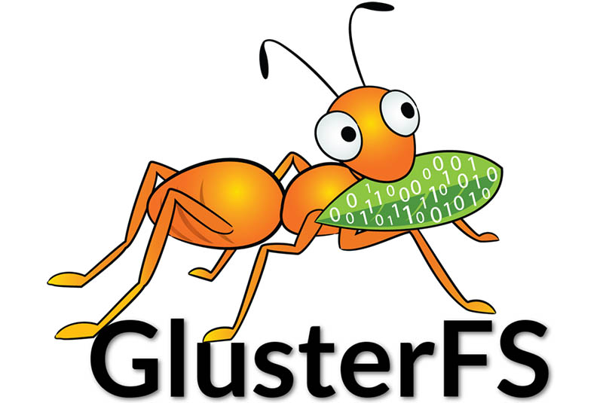
GlusterFS
Introduction: GlusterFS is a scalable network file system suitable for data intensive tasks across many servers.
Pros: High scalability, can handle petabytes of data, offers good data redundancy.
Cons: Lower performance for small file operations, can be complex to configure.
Use cases: Public and private cloud storage, media streaming, content delivery networks.
Unique Features: Elastic hash algorithm for data distribution, robust self healing capabilities.

Slide 7

CEPH
Introduction: Ceph is a unified, distributed storage system designed for excellent performance, reliability, and scalability.
Pros: High data redundancy, scalability, unified block, object and file storage in one system.
Cons: Higher complexity, can be resourceintensive, less performant for some specific workloads.
Use cases: Cloud storage, high performance computing, big data analytics.
Unique Features: Self managing, self healing capabilities, and offers a software defined storage solution.

